Slide 1

The Future of C#
Kevin Pilch
Principal Software Engineering Manager
Microsoft

Slide 2
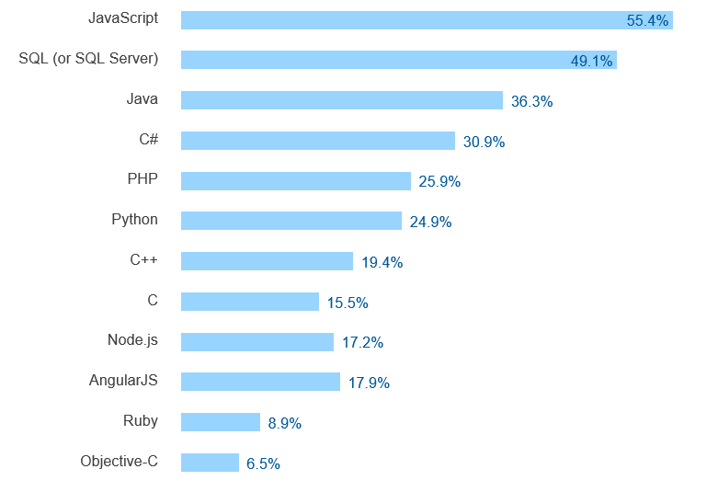

Stack Overflow - most popular technologies
http://stackoverflow.com/research/developer-survey-2016#technology-most-popular-technologies

Slide 3
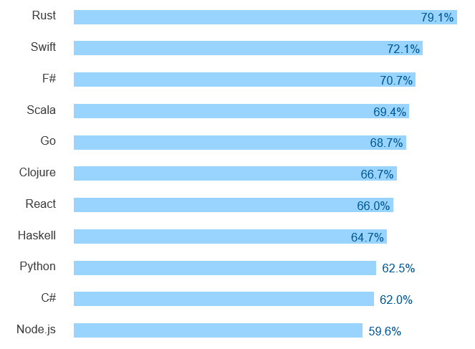
Stack Overflow - most loved technologies
http://stackoverflow.com/research/developer-survey-2016#technology-most-loved-dreaded-and-wanted

Slide 4
C# Evolution – A balancing act
Aggressively improve
Improve existing development
Embrace new paradigms
Stay simple
Attractive to new users
Stay true to the spirit of C#

Slide 5
.NET - changing our tune…
Run on Windows
.NET as system component
Run on VM (CLR)
Black box compilers
Edit in Visual Studio
Proprietary
Run everywhere
Deploy with app
Compile to native
Open compiler APIs
Use your favorite editor
Open source

Slide 6
Roslyn – the C# language engine
There should only need to be
one code base in the world
for understanding C#
IDEs and editors
Linters and analysis tools
Fixing and refactoring
Source generation
Scripting and REPLs
… Oh, and compiling!

Slide 7
Demos

Slide 8
C# 6 - recap
Expression bodied members
String Interpolation
Conditional access operator
nameof
Using static
Exception Filters
Interactive window

Slide 9
C# 7 – coming soon
Tuples
Patterns
Local functions
Binary literals
Digit separators
“ref” locals and returns
“Tasklike” async methods
Out “var”
(soon) Throw expressions
(soon) More expression bodied members

Slide 10
C# 7 – “ref” locals and returns
ref PhysicalObject GetAsteroid(Position p)
{
int index = p.GetIndex();
return ref Objects[index];
}
ref var a = ref GetAsteroid(p);
a.Explode();

Slide 11
C# 7 – “tasklike” async methods
async ValueTask<int> ComputeScore()
{
await Task.Delay(TimeSpan.FromSeconds(10));
return 42;
}

Slide 12
C# 7 – out var
if (int.TryParse(args[0], out var x) && x > 0)
{
WriteLine(x);
}
else
{
throw new ArgumentOutOfRangeException();
}

Slide 13
C# 7 – throw expressions
class Customer
{
readonly string name;
public Customer(string name)
{
this.name = name ?? throw new ArgumentNullException(nameof(name));
}
}

Slide 14
C# 8 – early thoughts
Non-nullable reference types
More patterns
Records
Async streams
You tell us – http://github.com/dotnet/roslyn

Slide 15
C# 8 – Nullable and non-nullable reference types
string? n; // Nullable reference type
string s; // Non-nullable reference type
n = null; // Sure; it's nullable
s = null; // Warning! Shouldn’t be null!
s = n; // Warning! Really!
WriteLine(s.Length); // Sure; it’s not null
WriteLine(n.Length); // Warning! Could be null!
if (n != null) { WriteLine(n.Length); } // Sure; you checked
WriteLine(n!.Length); // Ok, if you insist!

Slide 16
C# 8 – More patterns
if (o is Point p && p.X == 5) { WriteLine($"Y: {p.Y}"); }
if (o is Point { X: var x, Y: var y } && x == 5) { WriteLine($"Y: {y}"); }
if (o is Point { X: 5, Y: var y }) { WriteLine($"Y: {y}"); }
if (o is Point(5, var y)) { WriteLine($"Y: {y}"); }

Slide 17
C# 8 – Records
class Person(string First, string Last);
class Person : IEquatable<Person>
{
public string First { get; }
public string Last { get; }
public Person(string First, string Last) { this.First = First; this.Last = Last; }
public (string First, string Last) Deconstruct() => (First, Last);
public bool Equals(Person other)
=> other != null && First == other.First && Last == other.Last;
public override bool Equals(object obj) => obj is Person other ? Equals(other) : false;
public override int GetHashCode() => GreatHashFunction(First, Last);
…
}

Slide 18
Kevin Pilch
kevinpi@microsoft.com
@Pilchie
http://roslyn.io

